Slide 1
Genre
Horror Movie Evolution
Abby, Madison, and CJ

Slide 2
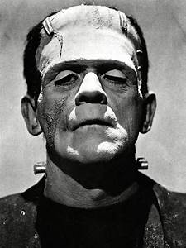
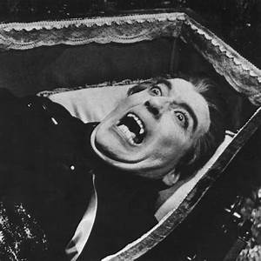
1930-1960
Scary movies during this period of time typically had the same characteristics. Early horror movies revolved around the fear of creatures or folktales about monsters. They tapped into the idea that something from our imagination exist. Some classic examples are:
Frankenstein
Dracula
The Wolf Man
The Mummy
The Blob

Slide 3
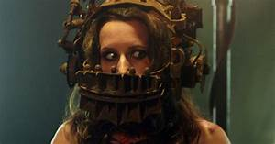
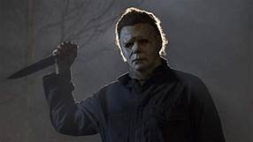
1960-2000
After monsters, scary films took a turn. The movies during this age were all gory and murder based. There is always going to be a scary man behind the door- so be ready for a jump scare. They didn’t hold back on the blood shown or the how gruesome the killings were whether it were stabbings or cutting off the extremities. Don’t be the girl that runs back up the stairs.
Friday the 13th
Halloween series
Saw series
Scream

Slide 4
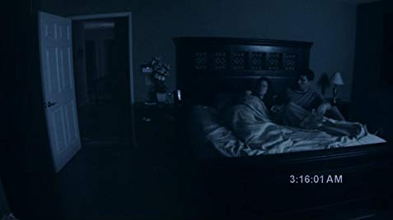
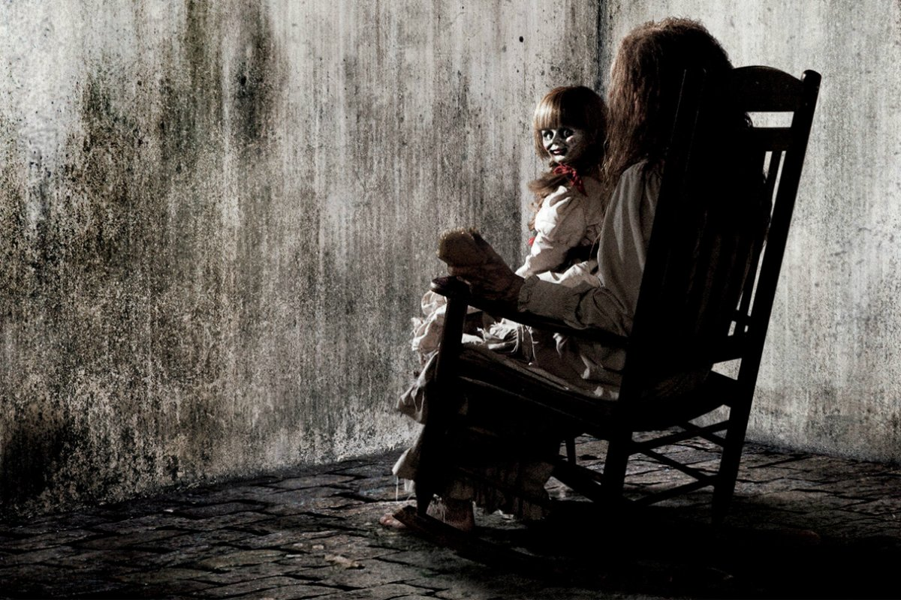
2000-2015
Paranormal activity took over in horror films along with adding more elements of religion such as the devil, crosses, and spirits. Of course movies in past history carried these elements such as The Exorcist and The Omen, but from the 2000s to 2015, this subgroup of horror became really popular around this time.
Paranormal Activity
The Conjuring
Insidious
The Orphanage

Slide 5
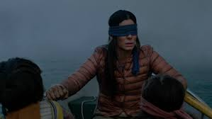
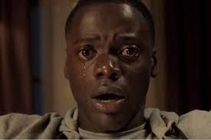
2015-2020
Jumping to the last section of the decade the scary movie they have changed to more psychological aspect on people. Focusing more on things we all could not manage losing like sight or being trapped in lout own head. This is seen in movies like-
Bird Box
Get Out
Quiet Place

